Slide 1
Module 14 Guided Lab - Hybrid Storage and Data Migration with AWS Storage Gateway File Gateway
Made for Professor Lanham A. by Amrit Singh

Slide 2
AGENDA
Accessing the AWS management console
Task 1: Reviewing the lab architecture
Task 2: Creating the primary and secondary S3 buckets
Task 3: Enabling cross-Region replication
Task 4: Configuring the File Gateway and creating an NFS file share
Task 5: Mounting the file share to the Linux instance and migrating the data
Task 6: Verifying that the data is migrated

Slide 3
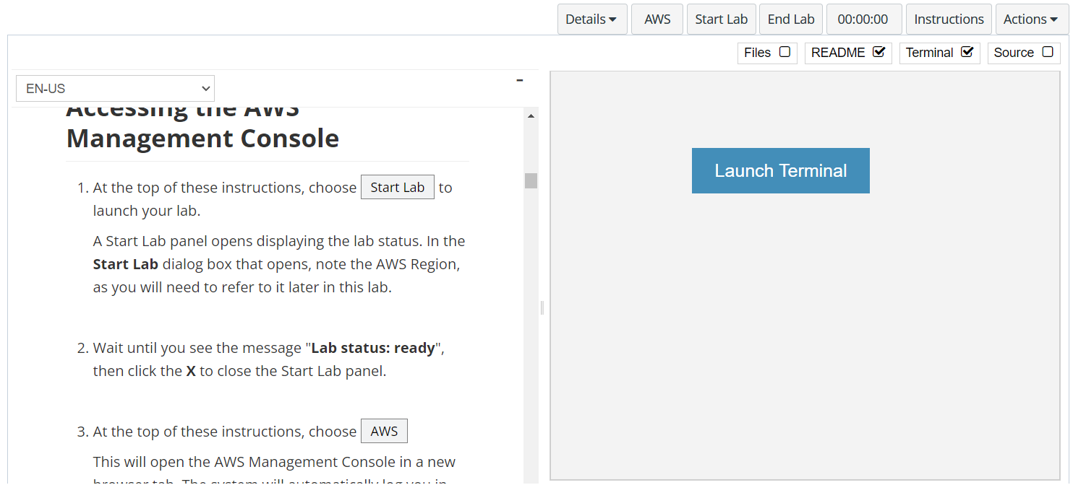
In aws labs click on start lab

Slide 4
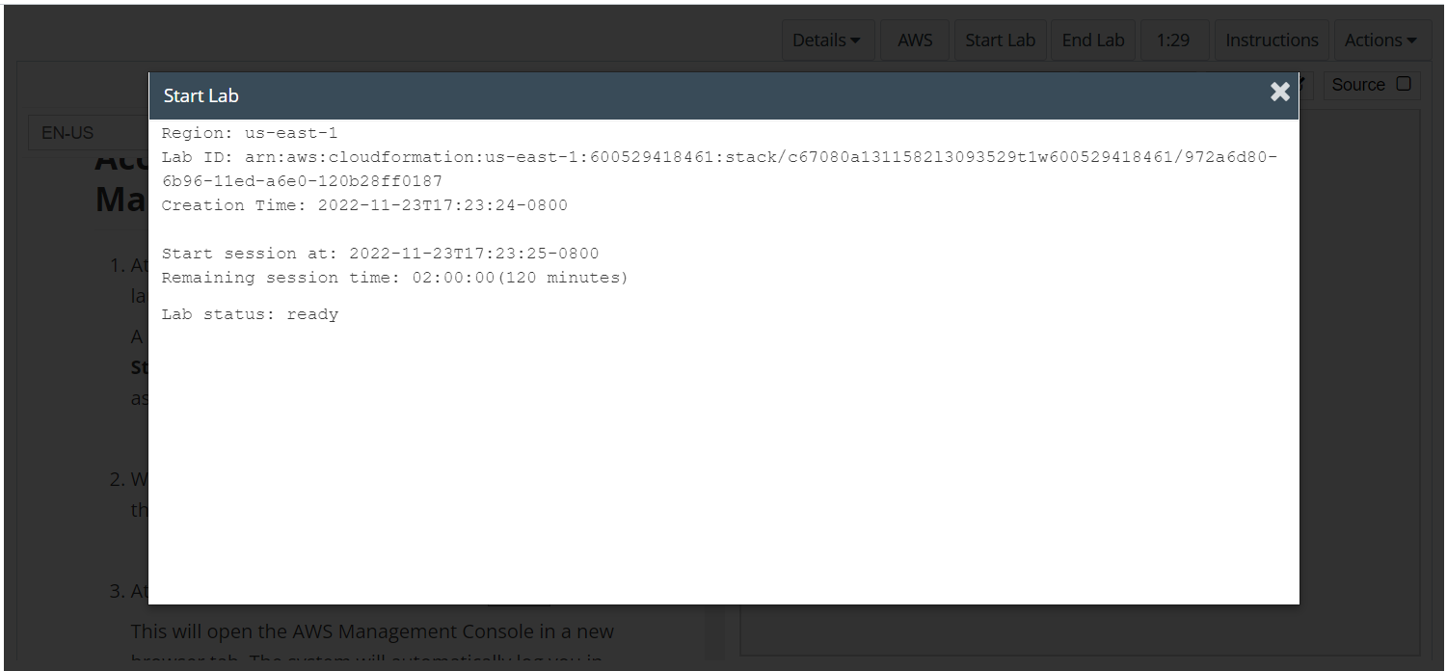
Wait to see lab ready status in the window then press x and click on aws to launch console

Slide 5
Task 1: Reviewing the lab architecture

Slide 6
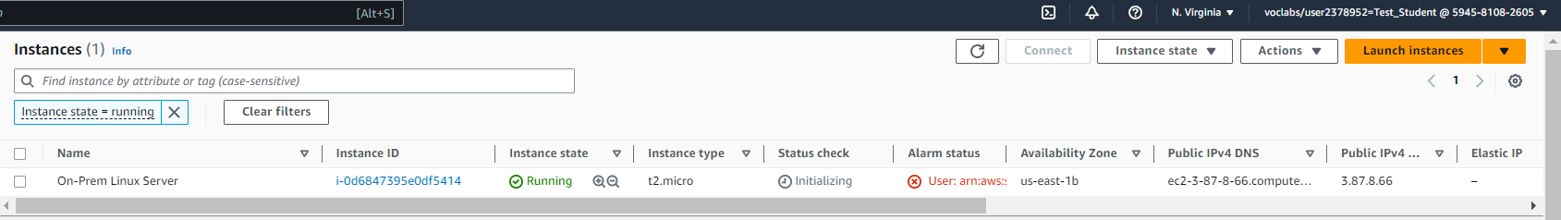
Explore the environment
A Linux EC2 instance that emulates an on-premises server is deployed to the us-east-1 (N. Virginia) Region. The Storage Gateway virtual appliance is deployed to the same Region as the Linux server

Slide 7
Task 2: Creating the primary and secondary S3 buckets

Slide 8
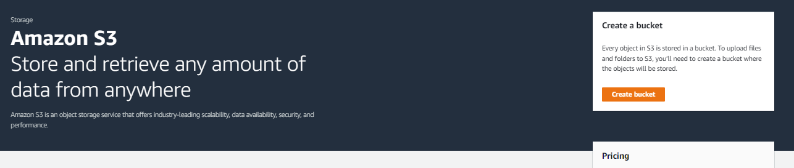
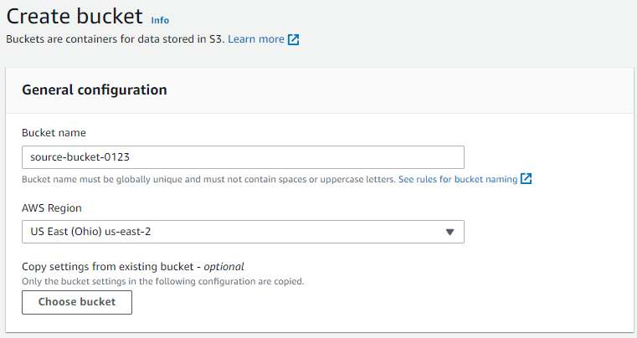
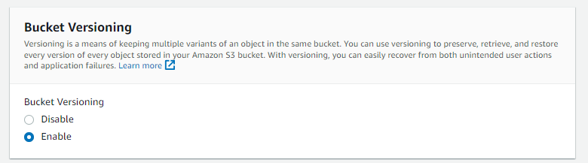
Open the s3 console
On the Services menu, choose S3.
Choose Create bucket
Choose Create bucket then configure these settings:
Bucket name: Create a name that you can remember easily. It must be globally unique.
Region: US East (Ohio) us-east-2
Bucket Versioning: Enable

Slide 9
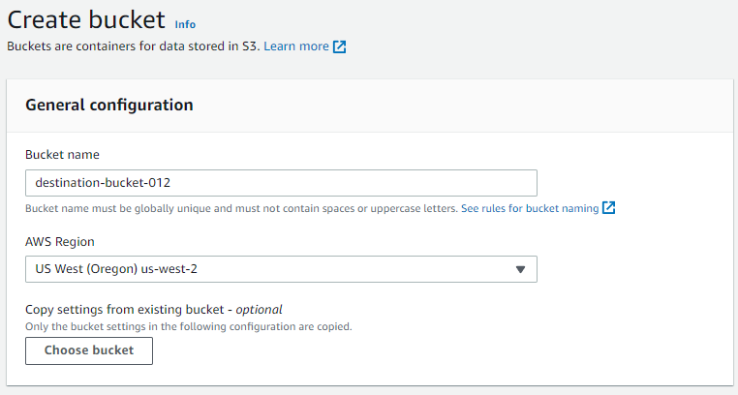
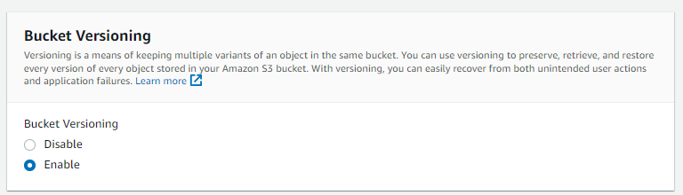
Create a new bucket in s3
Repeat the previous steps in this task to create a second bucket with the following configuration:
Bucket name: Create a name you can easily remember. It must be globally unique.
Region: US West (Oregon) us-west-2
Versioning: Enable

Slide 10
Task 3: Enabling cross-Region replication

Slide 11
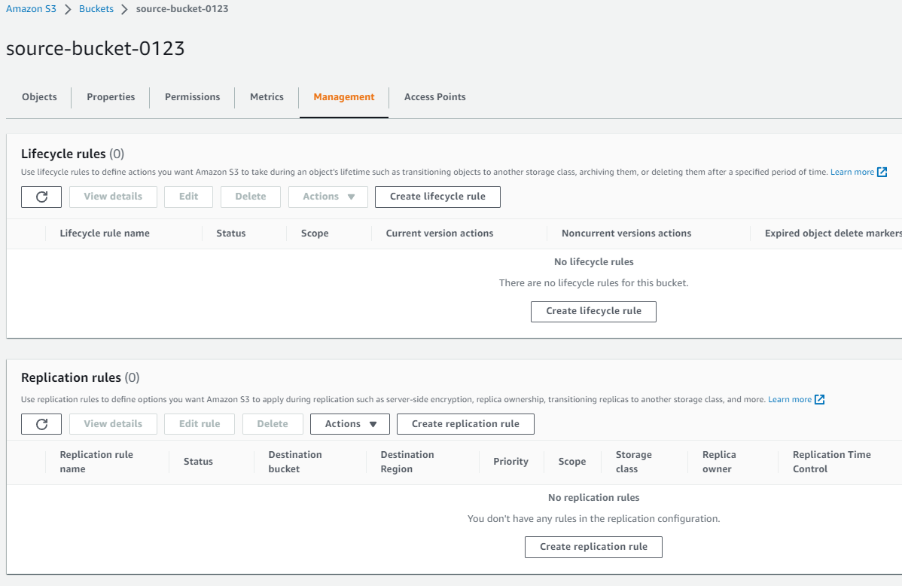
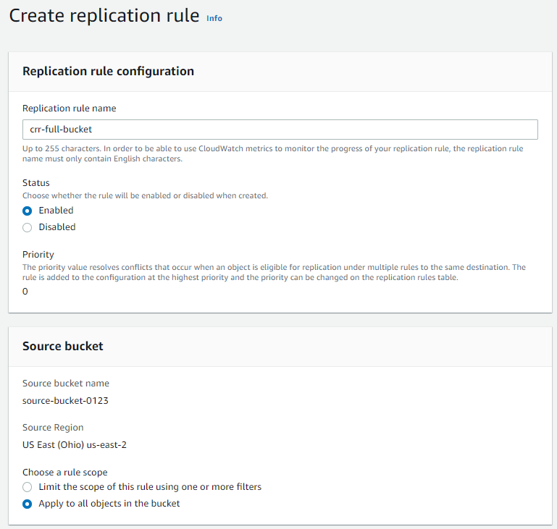
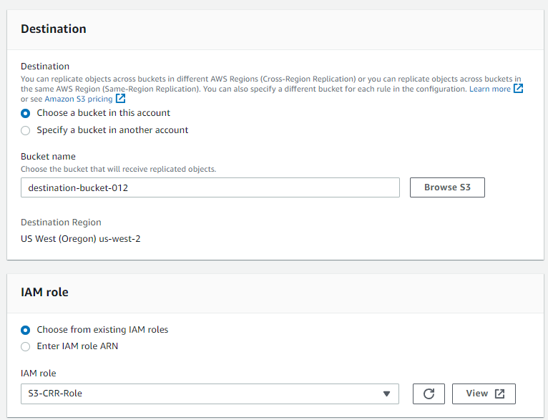
Download the files from aws labs and then upload them to s3
Select the name of the source bucket that you created in the US East (Ohio) Region.
Select the Management tab and under Replication rules select Create replication rule
Configure the Replication rule:
Replication rule name: crr-full-bucket
Status Enabled
Source bucket:
For Choose a rule scope, select Apply to all objects in the bucket
Destination:
Choose a bucket in this account
Choose Browse S3 and select the bucket you created in the US West (Oregon) Region.
Select Choose path
IAM role: S3-CRR-Role

Slide 12
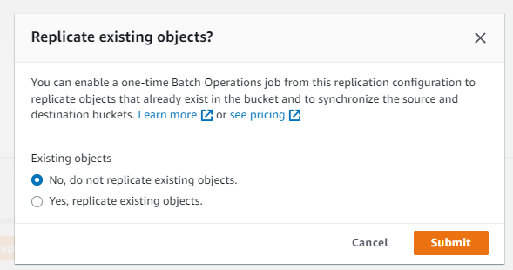
Don’t replicate existing objects and save
Choose Save. When prompted, if you want to replicate existing objects, choose No, and then choose Submit

Slide 13
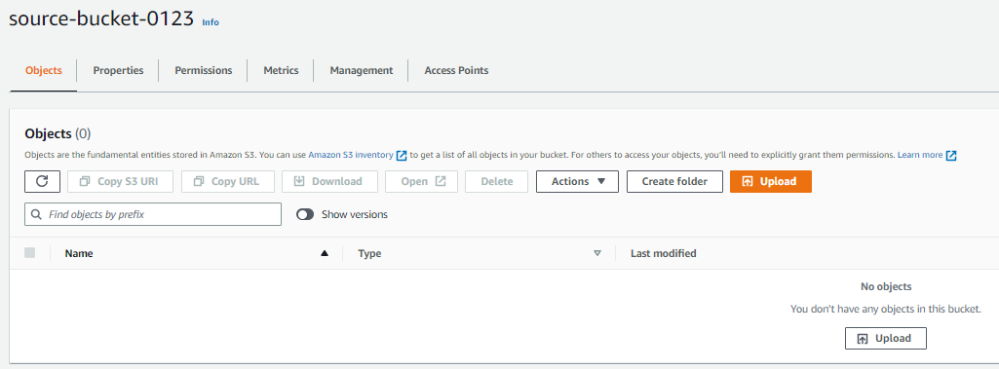
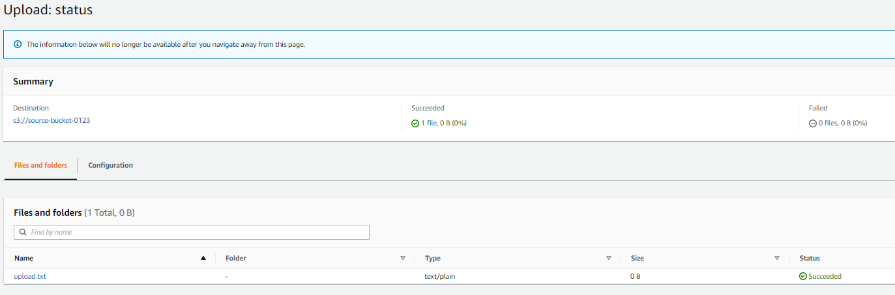
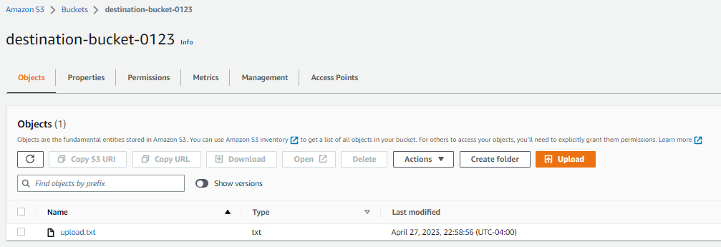
Upload the files to s3 source bucket
Return to and select the link to the bucket you created in the US East (Ohio) Region.
Choose Upload to upload a file from your local computer to the bucket.
Choose Add files, locate and open the file, then choose Upload
Wait for the file to upload, then choose Close. Return to the bucket you created in the US West (Oregon) Region.
The file that you uploaded should also now have been copied to this bucket.

Slide 14
Task 4: Configuring the File Gateway and creating an NFS file share

Slide 15
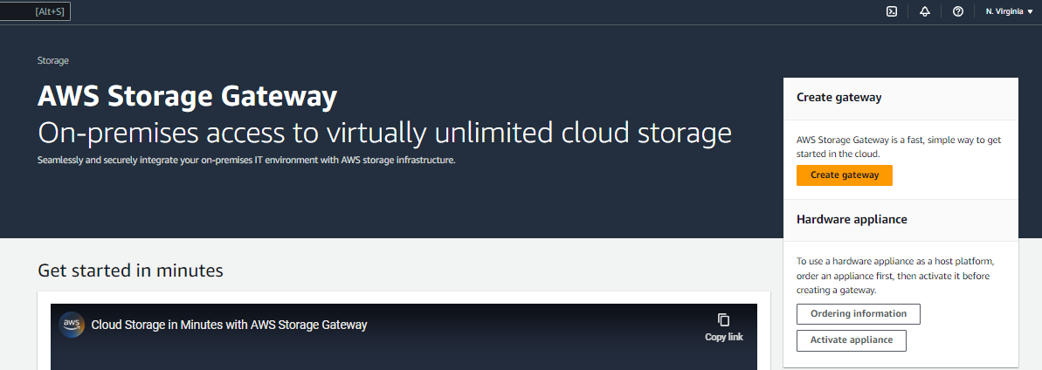
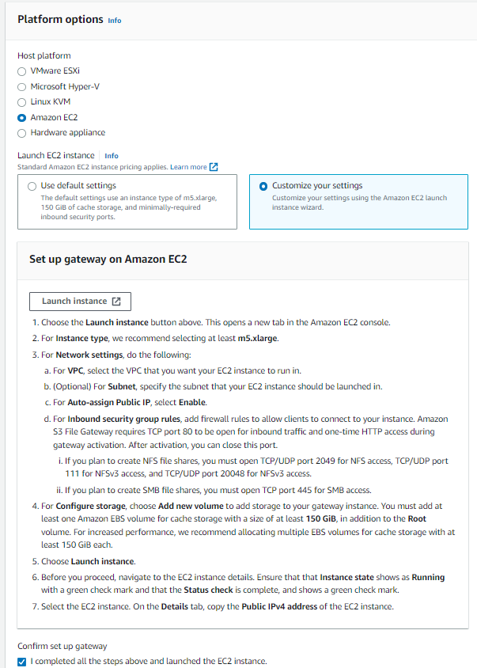
Open the storage gateway page
In the search box to the right of Services, search for and choose Storage Gateway to open the Storage Gateway console.
At the top-right of the console, verify that the current Region is N. Virginia.
Choose Create gateway then begin configuring the Step 1: Set up gateway settings:
Gateway name: File Gateway
Gateway time zone: Choose GMT -5:00 Eastern Time (US & Canada), Bogota, Lima
Gateway type: Amazon S3 File Gateway
Host platform: choose Amazon EC2, then choose the Launch instance button.

Slide 16
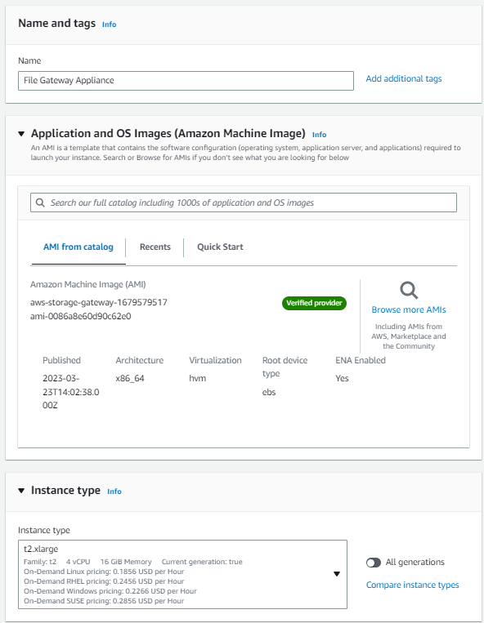
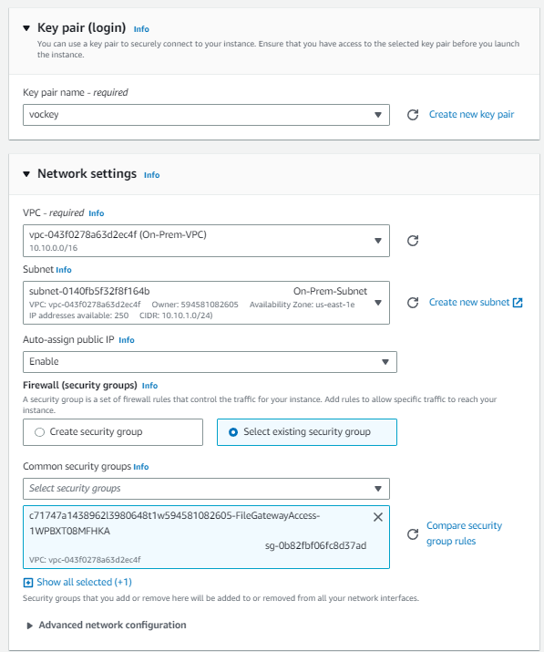
CONFIGURE THE EC2 SETTINGS AS SHOWN
In the Launch an instance screen, begin configuring the gateway as described:
Name: File Gateway Appliance
AMI from catalog: Accept the default aws-storage-gateway AMI.
Instance type: Select the t2.xlarge instance type
Key pair name - required: choose the existing vockey key pair.
Configure the network and security group settings for the gateway.
Next to Network settings, choose Edit, then configure:
VPC: On-Prem-VPC
Subnet: On-Prem-Subnet
Auto-assign public IP: Enable
Under Firewall (security groups), choose Select an existing security group.
For Common security groups:
Select the security group with FileGatewayAccess in the name
Also select the security group with OnPremSshAccess in the name
Verify that both security group now appear as selected (details on each will appear in boxes in the console)

Slide 17
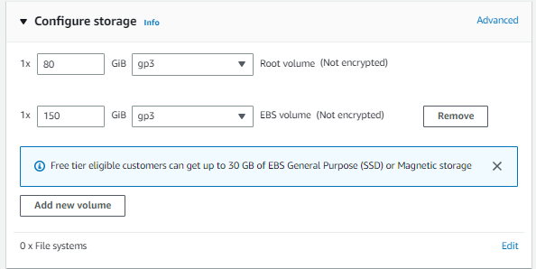
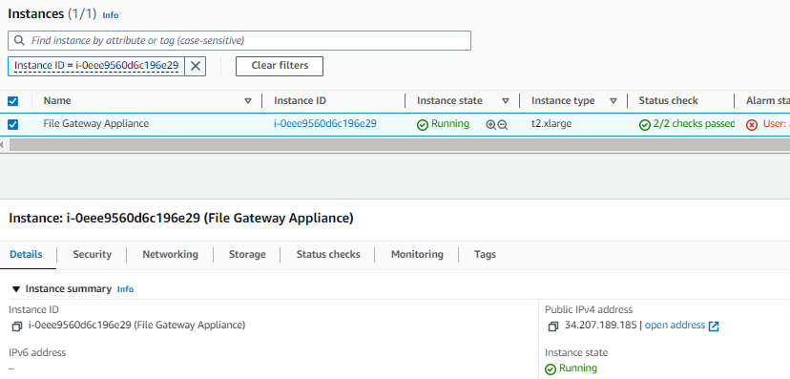
CONFIGURE THE EC2 storage AS SHOWN
Configure the storage settings for the gateway.
In the Configure storage panel, notice there is already an entry to create one 80GiB root volume.
Choose Add new volume
Set the size of the EBS volume to 150GiB
Finish creating the gateway.
A Success message displays
Monitor the status of the deployment and wait for Status Checks to complete.
Select your File Gateway instance, then in the Details tab below, locate the Public IPv4 address and copy it.

Slide 18
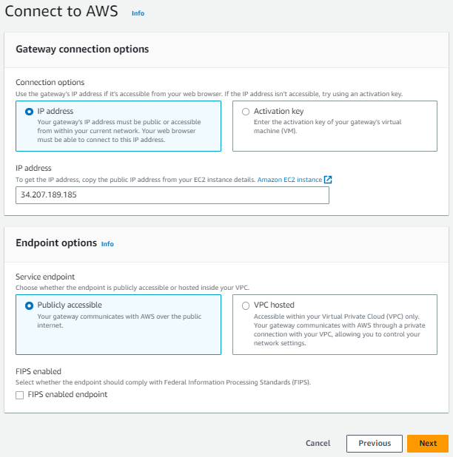
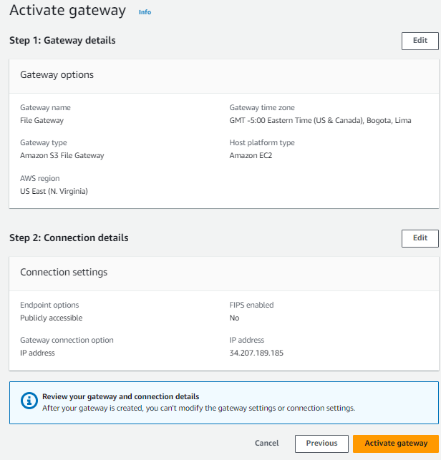
Configure the aws connect option of the file storage
Configure the Step 2: Connect to AWS settings:
For the Service endpoint, select Publicly accessible, and then choose Next
In the Gateway connection options:
For IP address, paste in the IPv4 Public IP address that you copied from your File Gateway Appliance instance
Choose Next
In the Step 3: Review and activate settings screen choose Activate Gateway

Slide 19
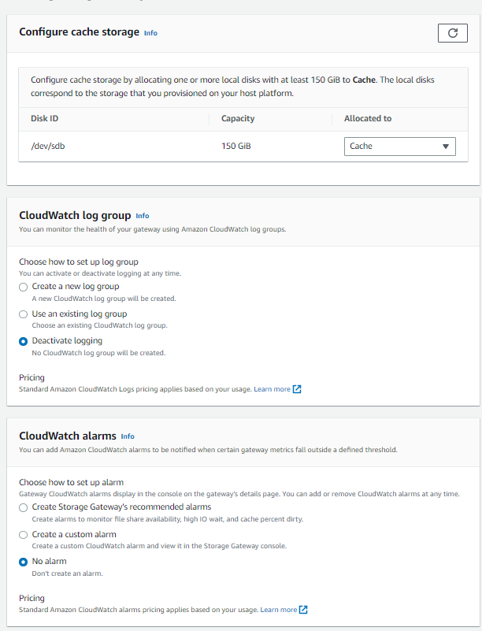
Configure the gateway step 4
Configure the Step 4: Configure gateway settings:
CloudWatch log group: Deactivate logging
CloudWatch alarms: No Alarm
Choose Configure
Wait for the local disks status to show that it finished processing (approximately 1 minute).
After the processing is complete, go to Allocated to and select Cache.
Choose Save changes

Slide 20
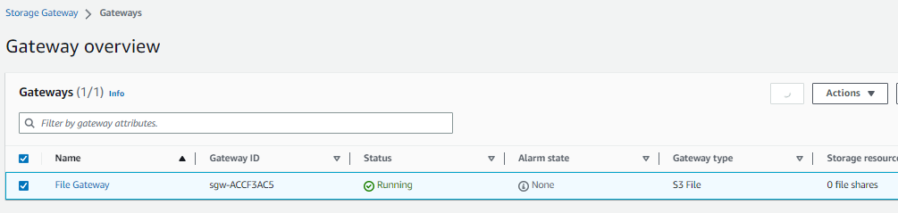
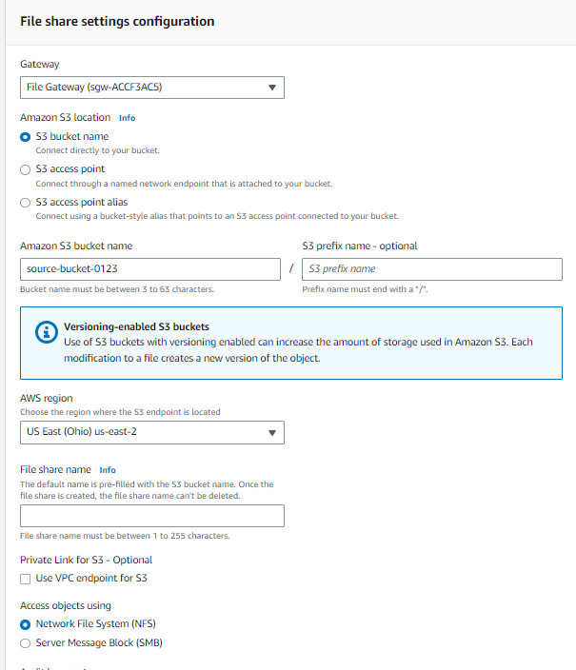
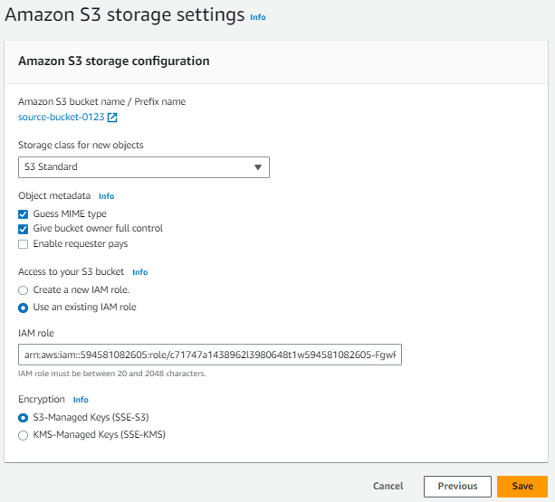
Create file share
Start creating a file share.
Wait for the File Gateway status to change to Running (approximately 1–2 minutes)
From the left side panel, choose File shares.
Choose Create file share
On the Amazon S3 storage settings screen, configure these settings:
Storage class for new objects: S3 Standard
Object metadata:
Guess MIME type
Give bucket owner full control
Enable Requester Pays
Access your S3 bucket: Use an existing IAM role
IAM role: Paste the FgwIamPolicyARN, which you can retrieve by following these instructions –
Choose the Details dropdown menu above these instructions
Select Show
Copy the FgwIamPolicyARN value
Choose Next

Slide 21
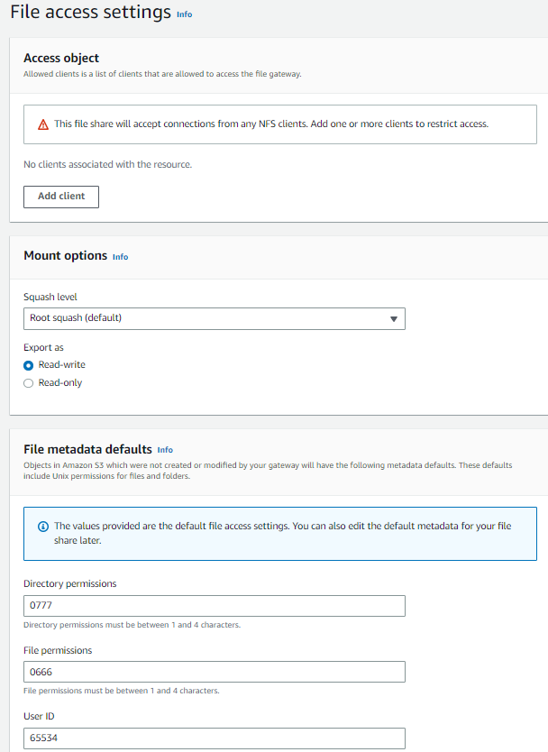
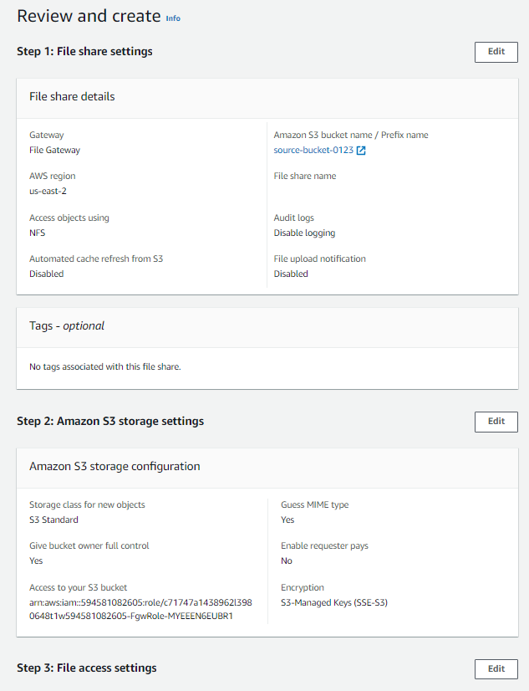
Configure the file access settings
In the File access settings screen, accept the default settings.
Choose Next
Scroll to the bottom of the Review and create screen, then select Create

Slide 22
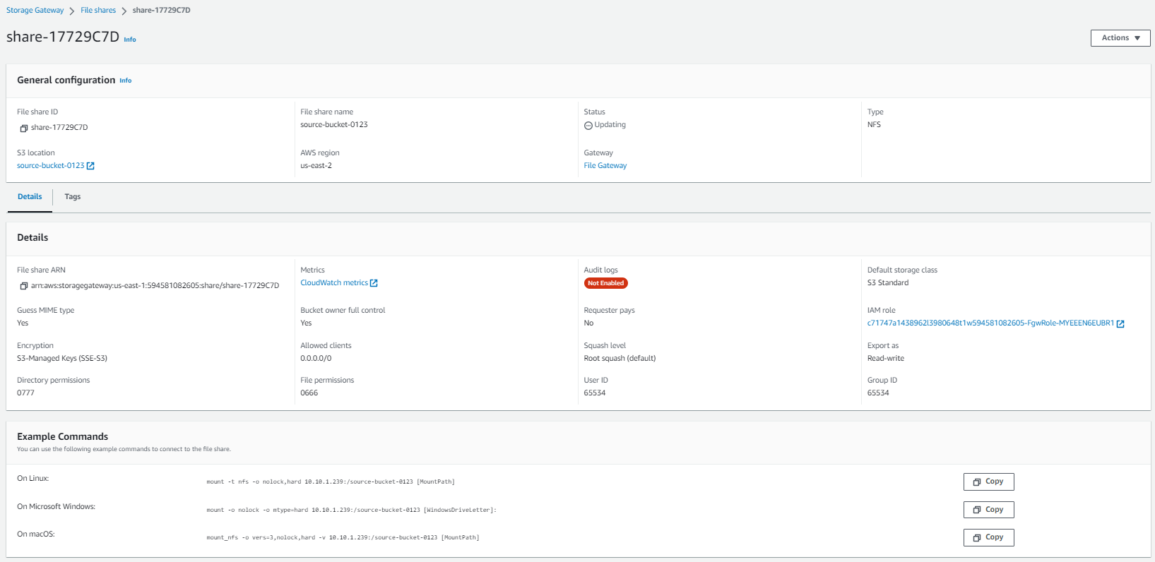
Copy the command to mount the fileshare
Select the file share that you just created by choosing the link.
At the bottom of the screen, note the command to mount the file share on Linux. You will need it for the next task.

Slide 23
Task 5: Mounting the file share to the Linux instance and migrating the data

Slide 24
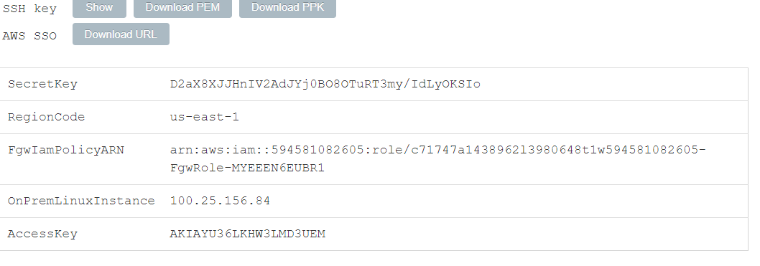
Return to the lambda console and create a new function
Connect to the On-Prem Linux Server instance
Above these instructions that you are currently reading, choose the Details dropdown menu, and then select Show
A Credentials window opens.
Choose the Download PPK button and save the labsuser.ppk file.
Note the OnPremLinuxInstance address, if it is displayed.
Exit the Details panel by choosing the X.
To use SSH to access the EC2 instance, you must use PuTTY.
Open putty.exe

Slide 25
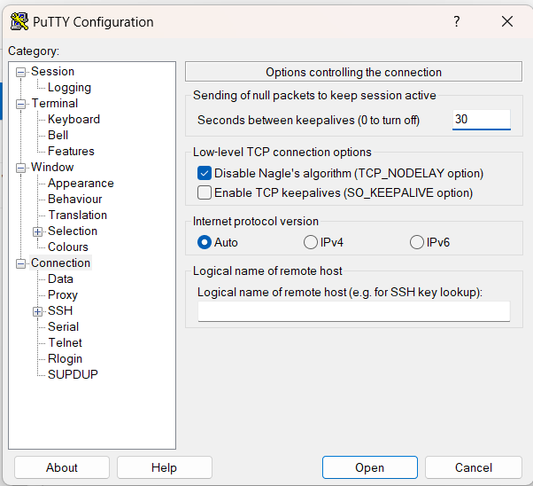
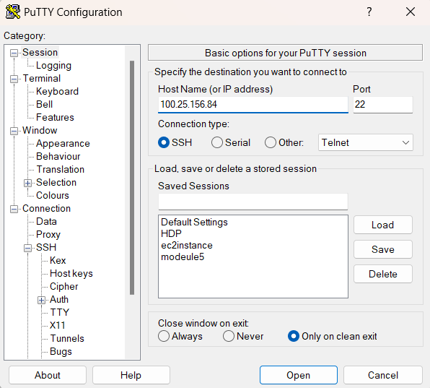
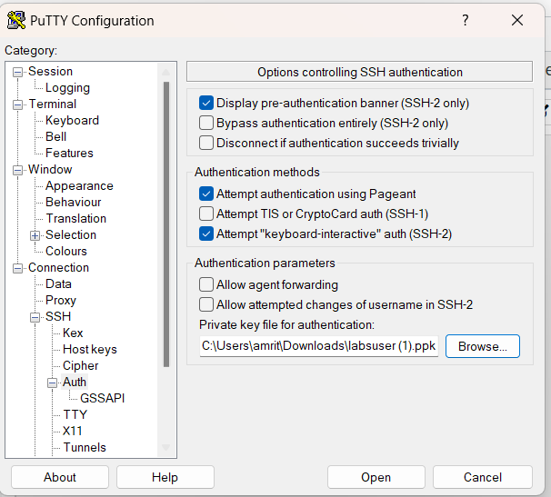
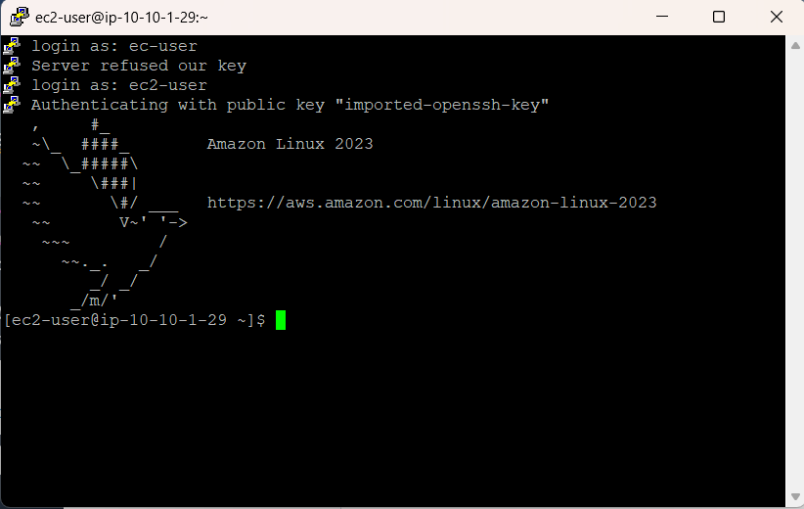
Change the code for the lambda function
To keep the PuTTY session open for a longer period of time, configure the PuTTY timeout:
Choose Connection
Seconds between keepalives:30
Configure your PuTTY session by using the following settings.
Choose Session
Host Name (or IP address): Paste the OnPremLinuxInstance for the instance you noted earlier
Alternatively, return to the Amazon EC2 console and choose Instances
Select the instance you want to connect to
In the Description tab, copy the IPv4 Public IP value
Back in PuTTY, in the Connection list, expand SSH
Choose Auth and expand Credentials
Under Private key file for authentication: Choose Browse
Browse to and select the labsuser.ppk file that you downloaded
To select the file, choose Open
Choose Open again
To trust and connect to the host, choose Accept.
When you are prompted with login as, enter: ec2-user
This action connects you to the EC2 instance.

Slide 26
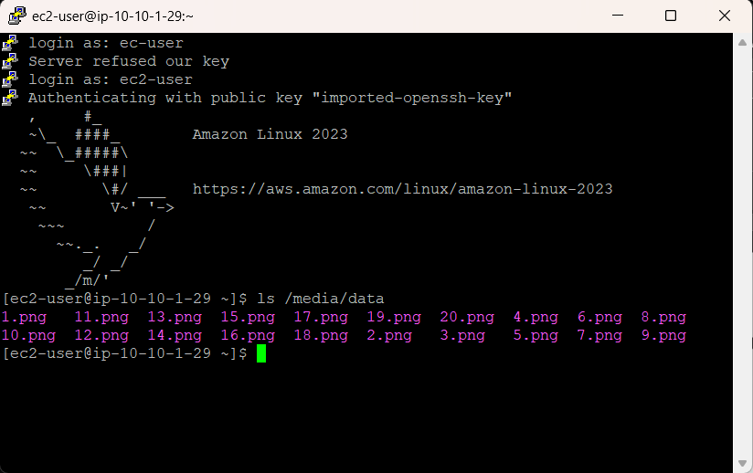
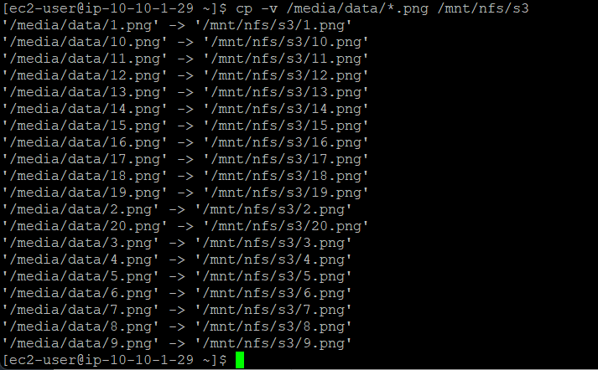
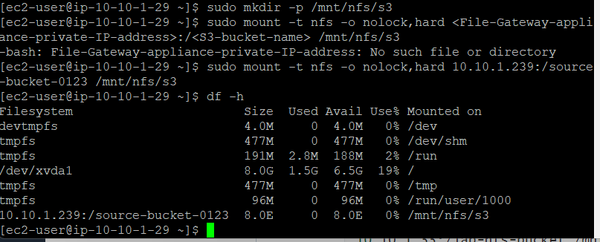
Scroll to the designer in lambda function
On the Linux instance, to view the data that exists on this server, enter the following command:
ls /media/data
Create the directory that will be used to synchronize data with your S3 bucket by using the following command:
sudo mkdir -p /mnt/nfs/s3
Mount the file share on the Linux instance by using the command that you located in the Storage Gateway file shares details screen at the end of the last task.
sudo mount -t nfs -o nolock,hard <File-Gateway-appliance-private-IP-address>:/<S3-bucket-name> /mnt/nfs/s3
Verify that the share was mounted correctly by entering the following command:
df –h
Now that you created the mount point, you can copy the data that you want to migrate to Amazon S3 into the share by using this command:
cp -v /media/data/*.png /mnt/nfs/s3

Slide 27
Task 6: Verifying that the data is migrated

Slide 28
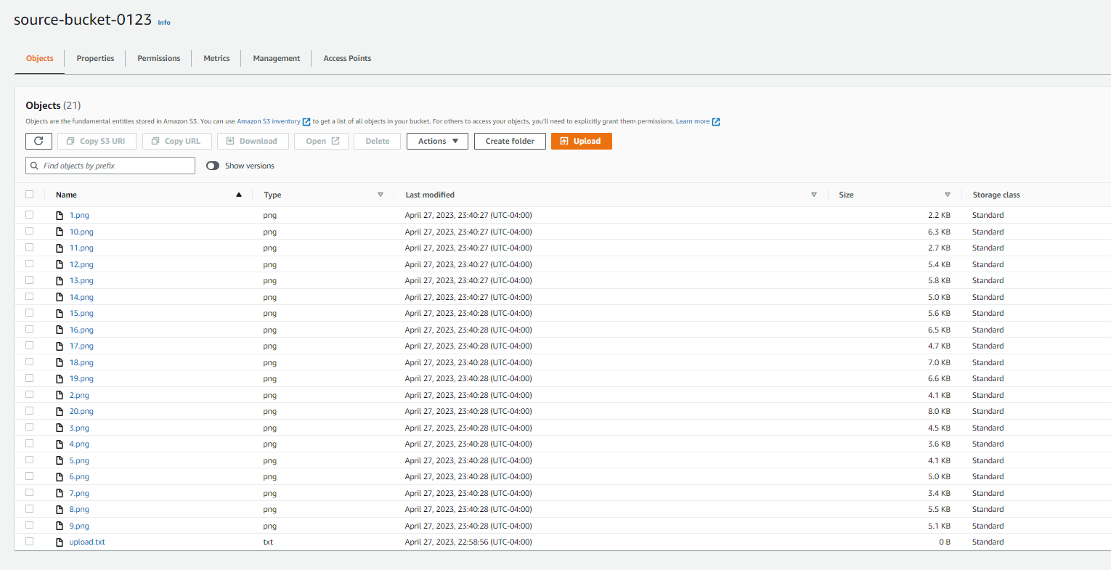
Go back to s3, and validate the new files
In the Services search box, search for and choose S3 to open the S3 console.
Select the bucket that you created in the US East (Ohio) Region.
Verify that the 20 image files are listed.
Return to the Buckets page and select the bucket that you created in the US West (Oregon) Region.
Verify that the images files were replicated to this bucket, based on the policy that you created earlier.

Slide 29
THANK YOU
Amrit Singh

